Slide 1

Manufacturing Defects Prediction
DA24 C4
27 October 2024
By Wan Mohd Azzid bin Wan Hossen

Slide 2

Page 02
Self Introduction
Education
Diploma in Management at Open University Malaysia (2010)
Work Experience
Ordnance Officer at Malaysian Army (2010 - 2021)
About Me
Interest in gaining new experience, knowledge & skills
10 years’ experience as an officer of organization & management
My motto: ‘Knowledgeable maketh success!’

Slide 3
Page 03
Course Timeline
Month 1
Month 4
1
Self Resilience Mastery
Communication Mastery
4
Advanced Deep Learning Techniques
Career Launchpad Mastery
Month 2
Month 5
2
Introduction to Data Science
Introduction to Python Programming
5
Final Review
Month 3
3
Introduction to Machine Learning
Introduction to Object Detection with AI

Slide 4
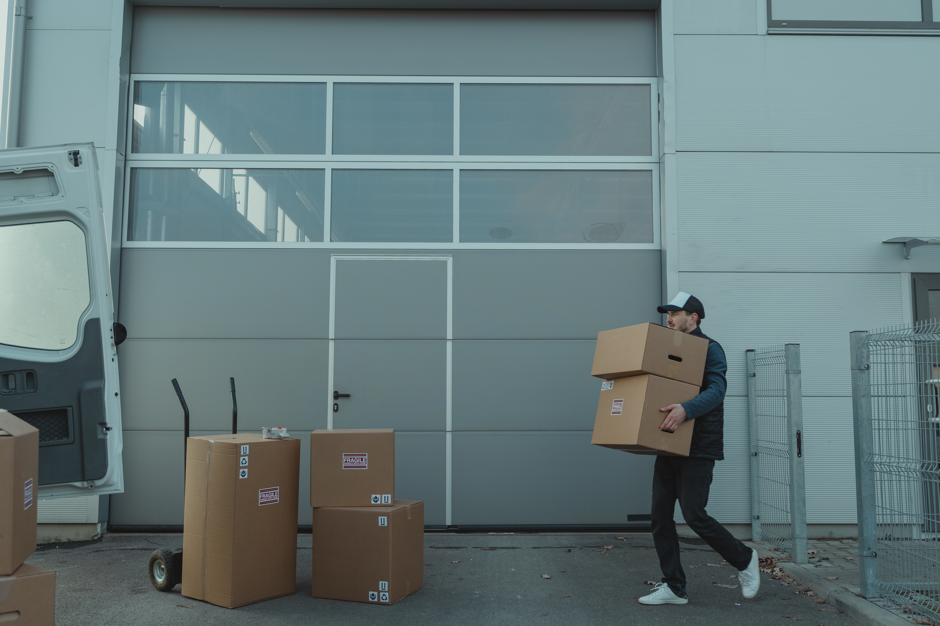
Page 04
Project Overview
Insights into Factors Influencing Defect Rates and Production Efficiency

Slide 5

Page 05
Project Problem Statement
Objective
This dataset provides insights into factors influencing defect rates in a manufacturing environment.
Identify primary factors contributing to manufacturing defects.
Balance the dataset effectively.
Predict defect rates with accuracy.

Slide 6

Page 06
Technology Stack
Exploratory Data Analysis
1
Pandas, NumPy, Matplotlib & Seaborn
Random Forest (Feature Importances)
Scaled & Balanced Values
2
MinMaxScaler
SMOTE
Model Development
3
Scikit-Learn
XGBoost & LightGBM
Model Deployment
4
Streamlit
FastAPI

Slide 7
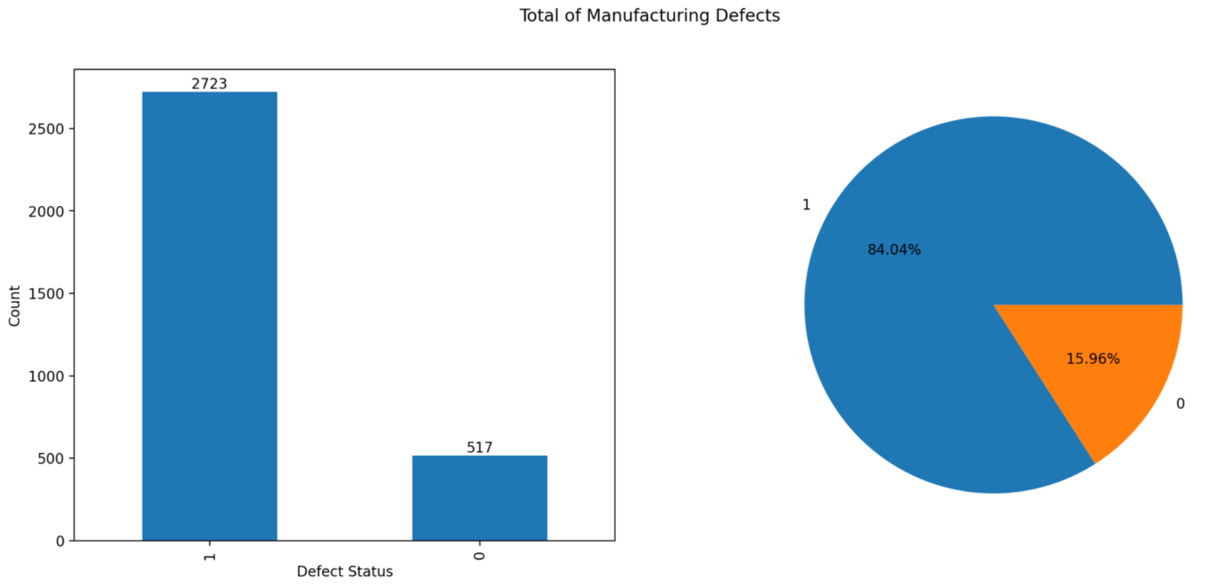
Page 07
Dataset Summary

Slide 8
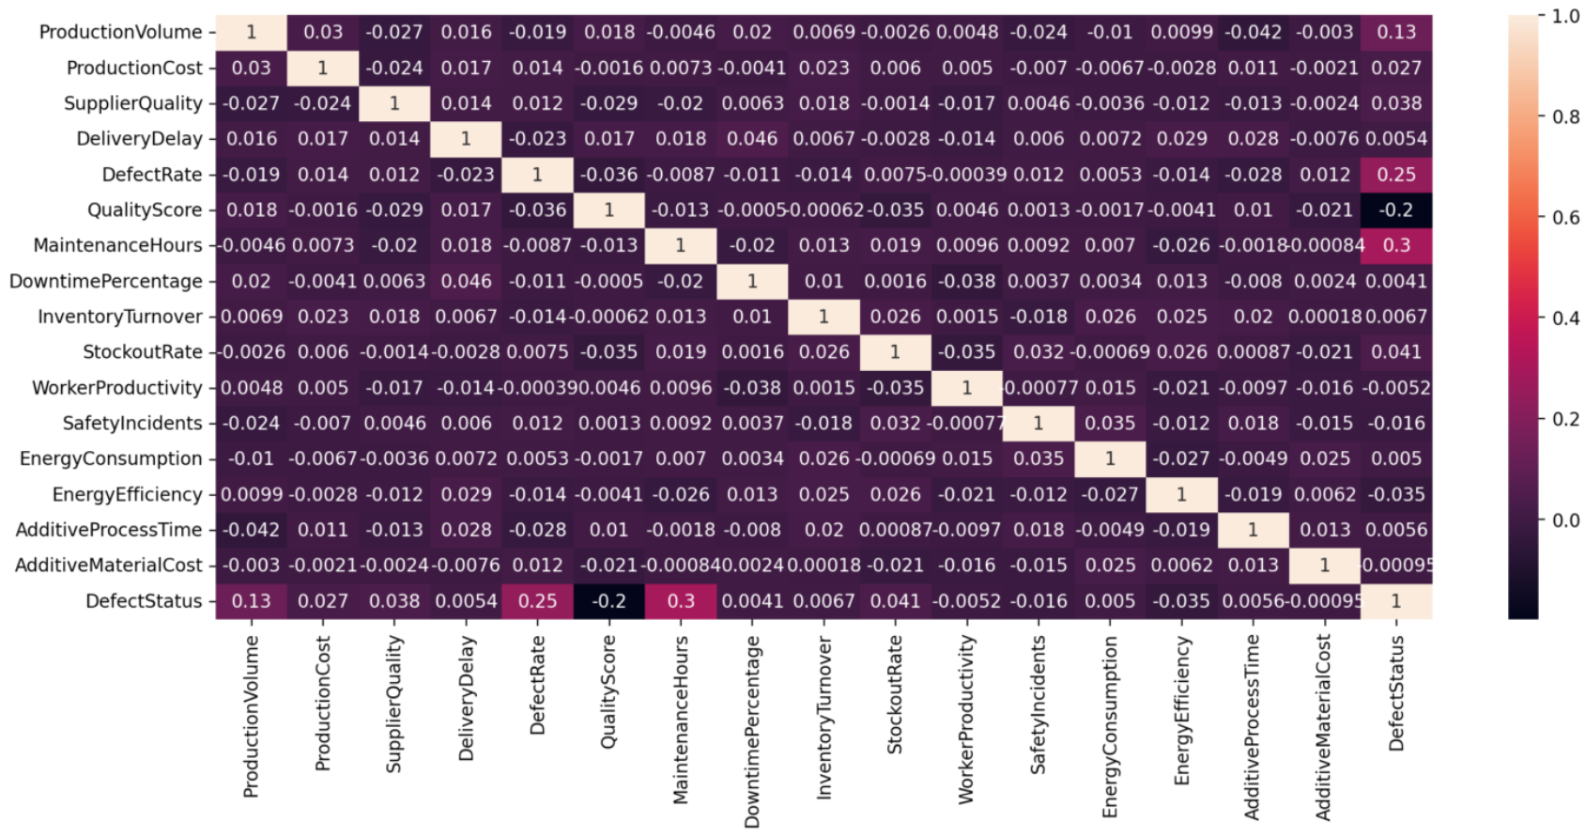
Page 08
Correlation Matrix

Slide 9
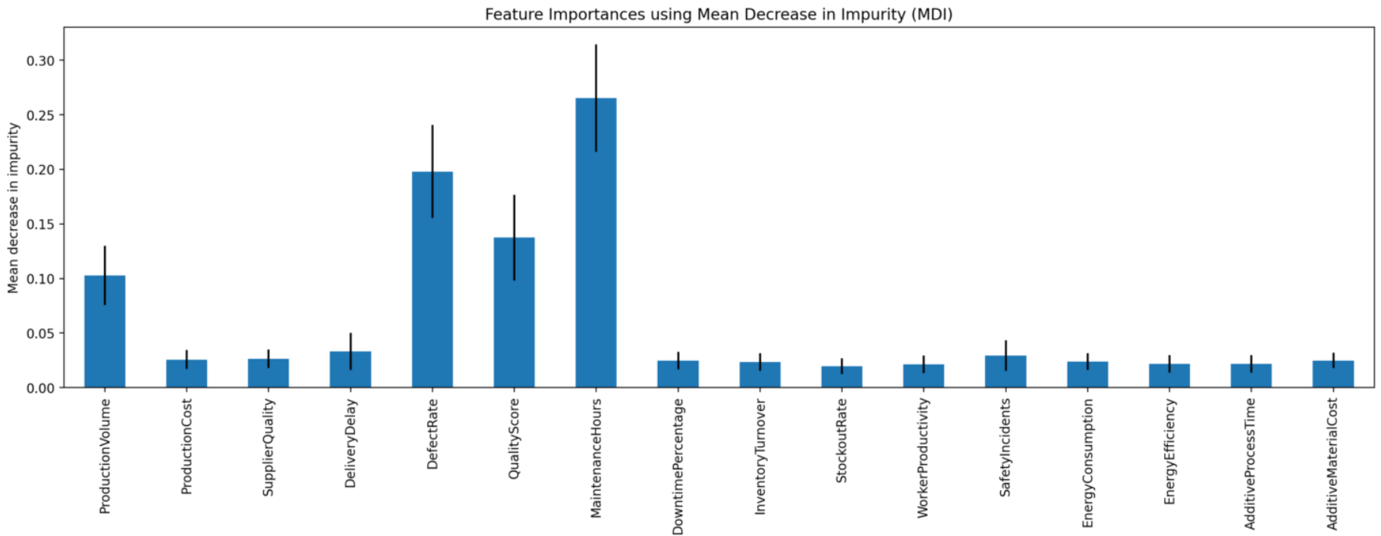
Page 09
Feature Importances (Random Forest)

Slide 10
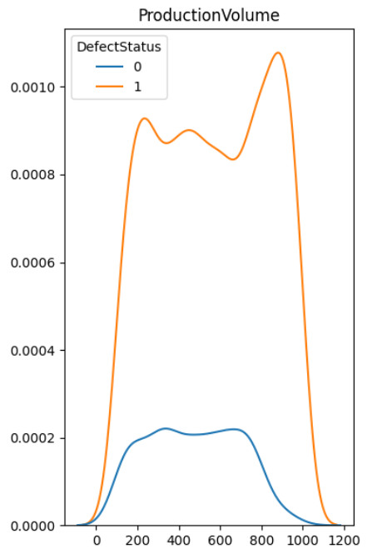
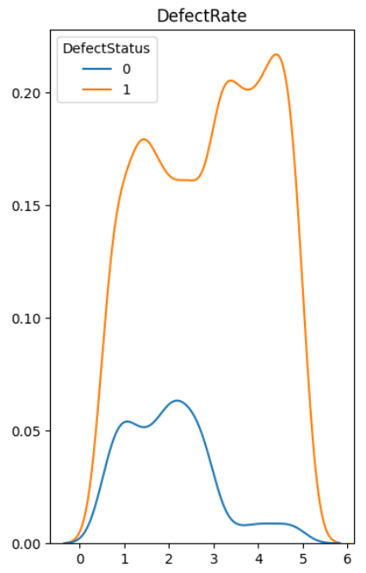
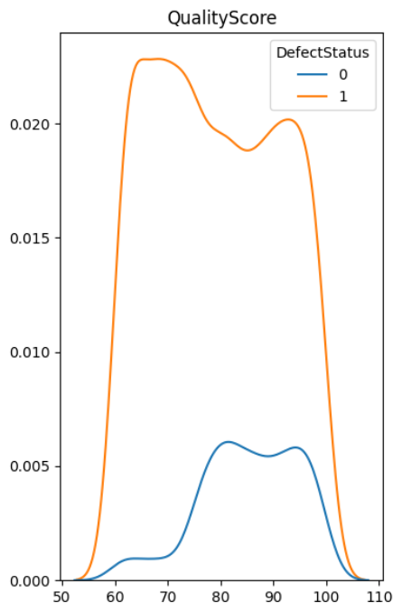
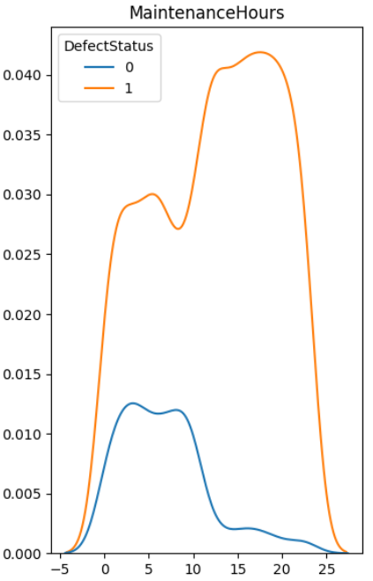
Page 10
Exploratory Data Analysis

Slide 11
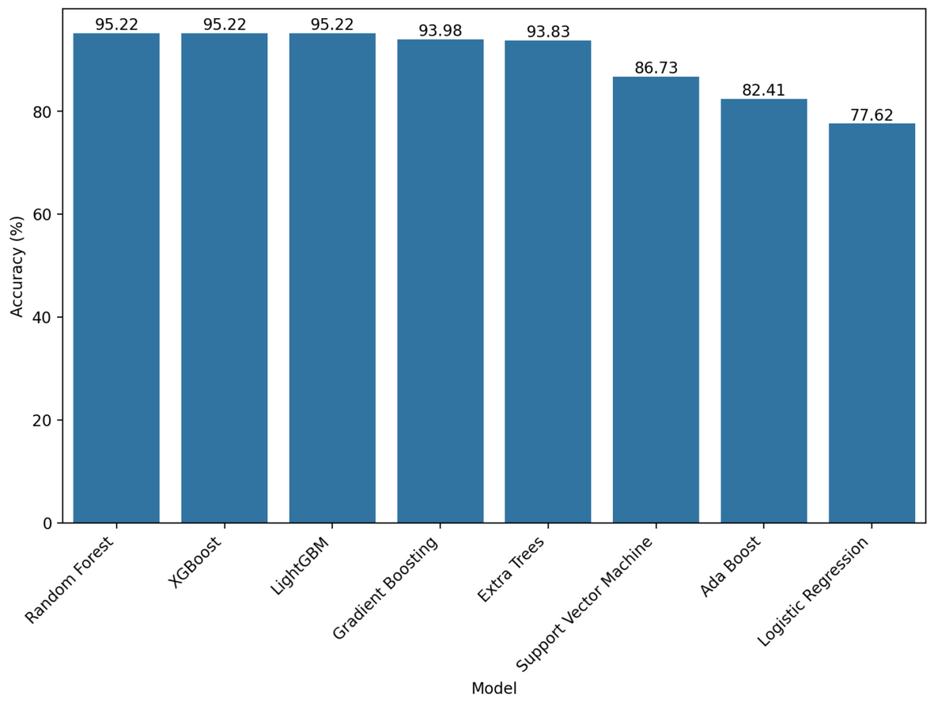
Page 11
Model Accuracy Comparison

Slide 12
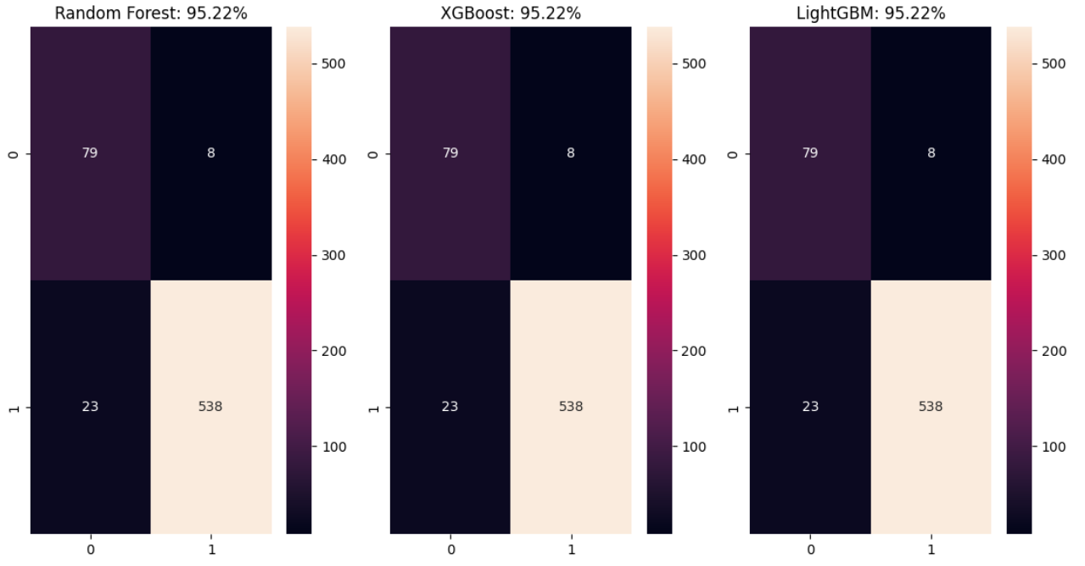
Page 12
Confusion Matrices

Slide 13
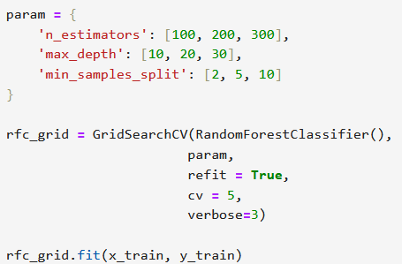
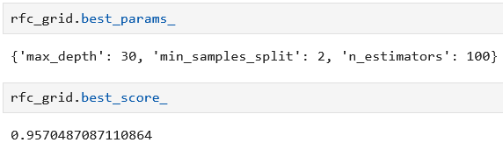
Page 13
Hyperparameter Tuning

Slide 14
Page 14
Project Timeline
Week 1 & 2
Week 12
1
Project Planning & Setup (2 Weeks)
5
Documentation & Deployment (1 Week)
Week 3 - 5
Week 13 - 14
2
Data Collection & Preparation (3 Weeks)
6
Evaluation & Iteration (2 Weeks)
Week 6 - 9
Week 15
3
Modeling & Analysis (4 Weeks)
7
Project Closure & Handover (1 Week)
Week 10 - 11
4
Insights & Reporting (2 Weeks)

Slide 15
Page 15
Project Budget
Item | Initial Investment
System Deployment (including personnel, data acquisition, infrastructure, software, testing & maintenenace) | RM 50,000 - RM 200,000

Slide 16


Page 16
Defect’s Factors
Number of units produced per day.
Quality ratings of suppliers.
Defects per thousand units produced.
Hours spent on maintenance per week.
Conclusion
Defect’s Prediction
Random Forest model proved the most useful & accurate.
The percentage of defects make the company choose the best decision.

Slide 17
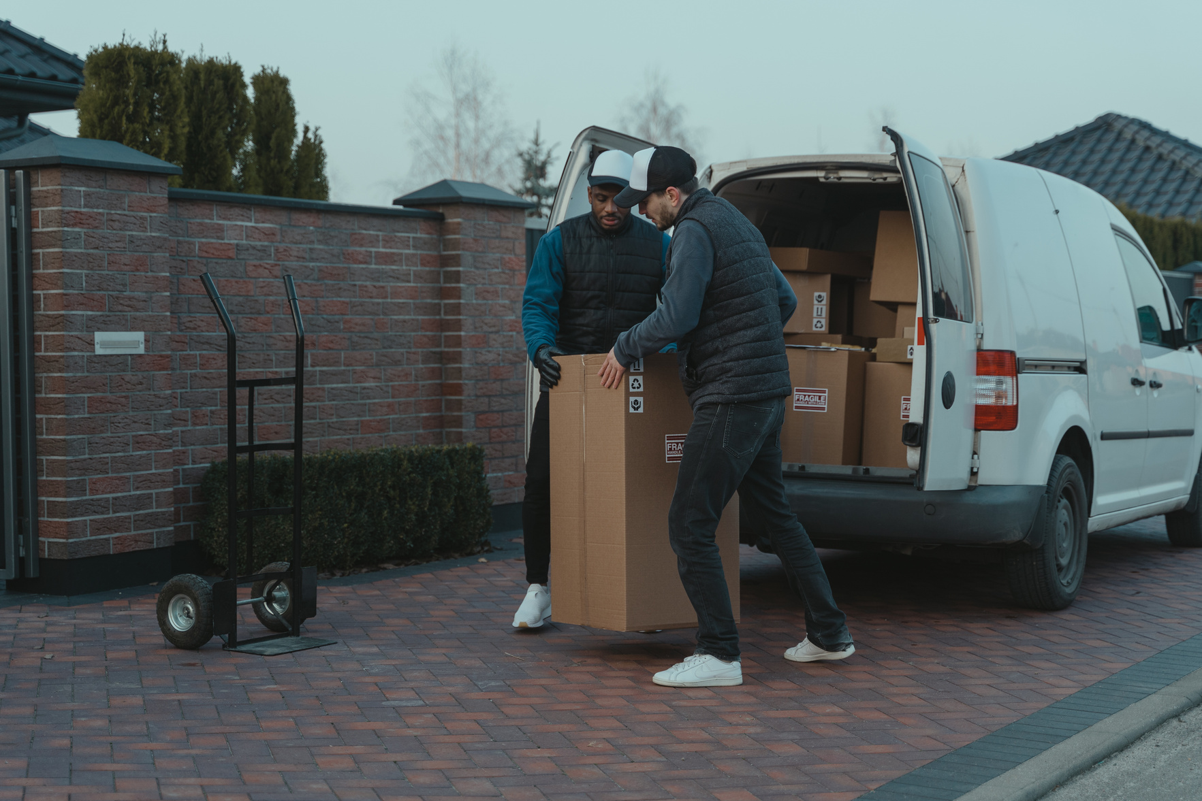
Page 17
Thank You For Your Time

